Slide 1
The Age That Women Have Babies: How a Gap Divides America
Lupi

Slide 2
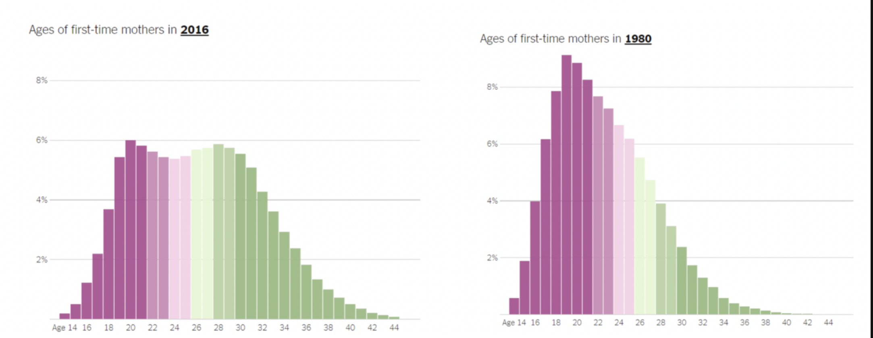
This data is based on birth certificate data from the National Center for Health Statistics.
Y Axis: Percentage of all mothers
X Axis: Age of First Time mothers

Slide 3
Bimodal
Right Skewed
The two peaks are around 20 and 29.
The median is around 20 and the mean is around 22.
1 year interval
Confusing appearance with x axis values
The Bimodal shape of the 2016 graph mirrors inequality in the US
Reduction of younger mothers specifically teenage mothers due to increase access to healthcare
Importance of these graphs to predict future population distribution as well as highlights the need to create support systems for younger mothers.

